Slide 1
How to Read a Scientific Paper
Scientific literacy is fundamental
for both research and writing

Slide 2
What we plan to achieve
1)identify suitable Specialist journals for your research
2)analyze and apply generic structures and linguistic features in research writing
3)exercise critical judgement in relation to your own and others’ work

Slide 3
Key Topics
Types of scientific papers
Organization of a paper
Actions to take-to properly read a paper
Difficulties in reading scientific papers

Slide 4
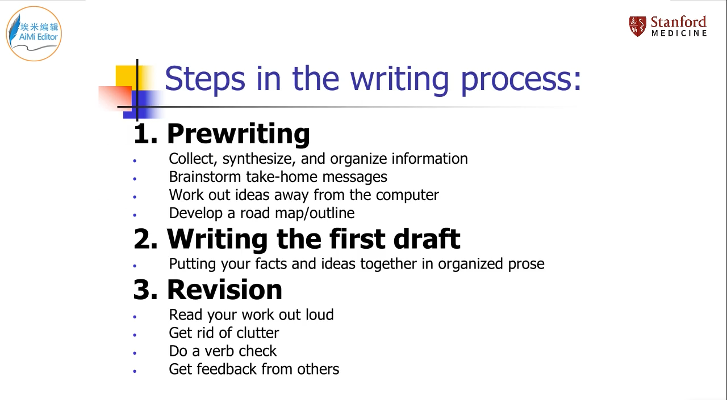

Slide 5
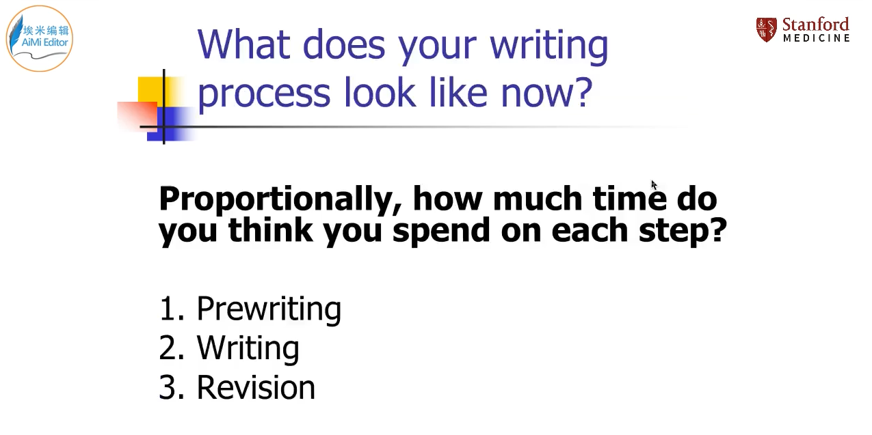

Slide 6
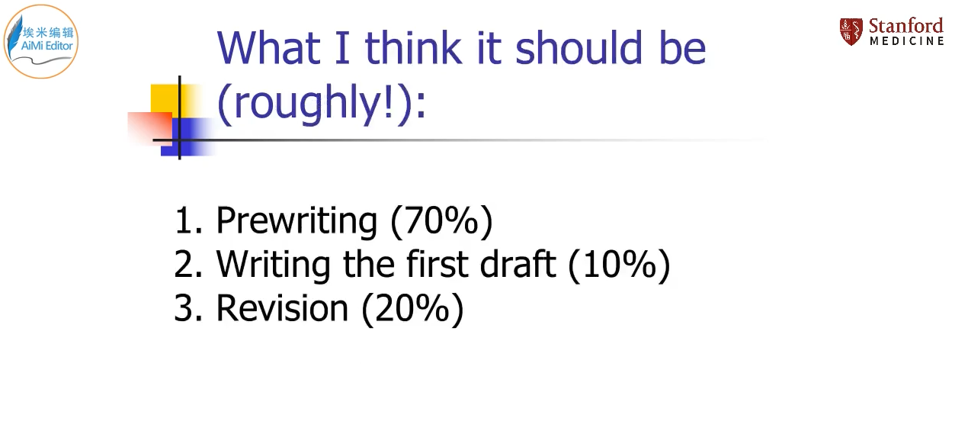

Slide 7
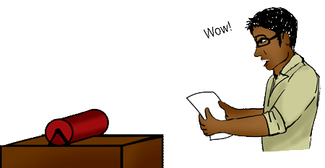
Why Read?
It’s Current!
Textbooks can be years out of date by the time they are published. Journals/conferences tell you what is happening…
RIGHT NOW!

Slide 8

Why Read?
It’s Current!
It Can Be Replicated!
Popular articles and books give you general information and results. Scholarly journals give you enough information that you could do the experiment yourself.
You can verify the research to see if you get the same results.

Slide 9
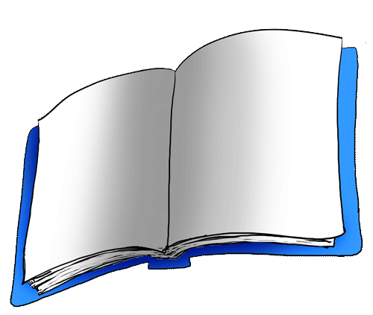
Why Read?
It’s Current!
It Can Be Replicated!
It Has Actual Data!
If you need to know exact results or properties for your own research…
Articles include actual data, uncertainties, conditions of the experiment, and much more.

Slide 10

Why Read?
It’s Current!
It Can Be Replicated! It Has Actual Data!
You Can Evaluate The Conclusions!
Do You Believe It… Or Not?
Articles provide the authors’ explanation of their results and conclusions. You can see their assumptions and determine whether you believe them or not.

Slide 11
Why Read?
So, There You Have It…
Current
It’s the most up to date stuff
Has Raw Data
Save time – use their results
Replicable
I can redo the experiment myself
Shows Logic
Do you believe it… or not?
All the Reasons to Read Scientific Papers

Slide 12
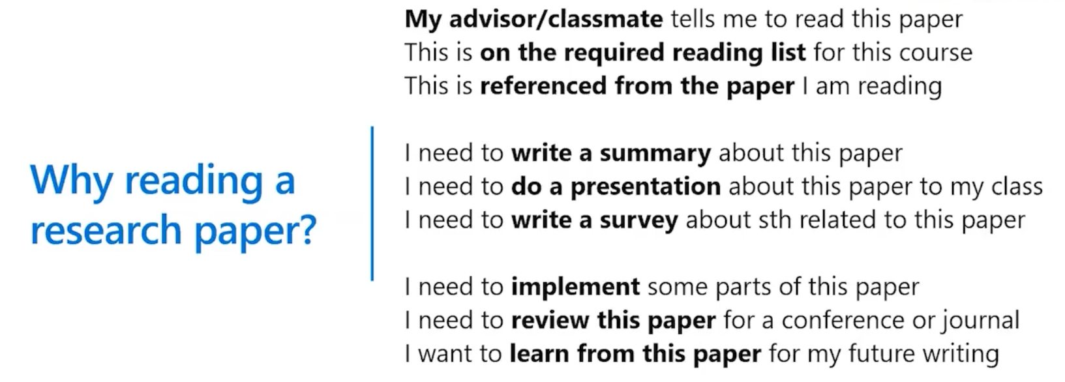
微软公司前执行副总裁沈向洋博士分享对科研论文阅读、撰写的宝贵经验 https://mp.weixin.qq.com/s/GRY5tbRa3Oa-mD8PA4P2Xg

Slide 13
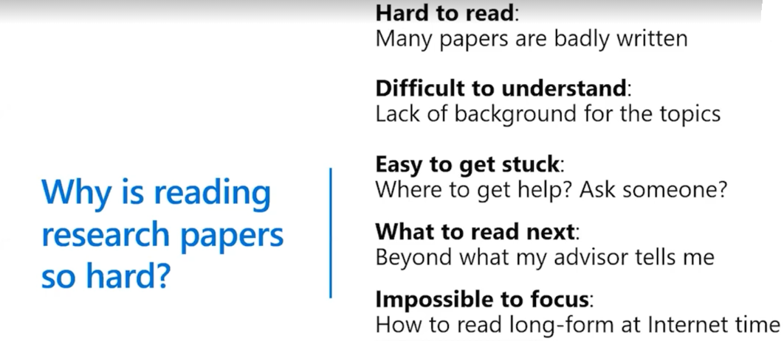
http://www.cs.cmu.edu/~jrs/sins.html

Slide 14
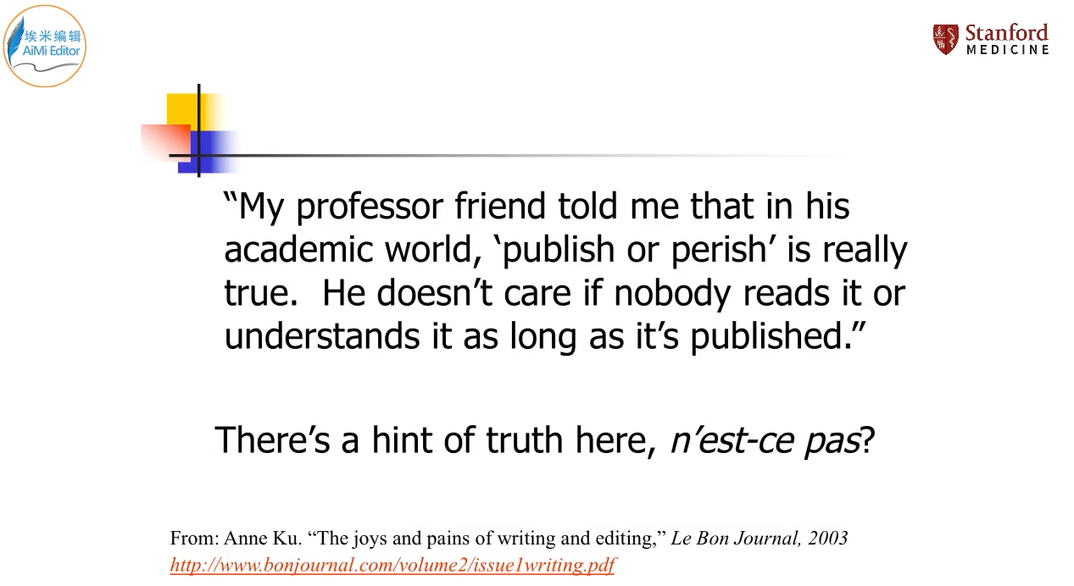

Slide 15
Difficulties in Reading Papers
Papers can be poorly written:
—some scientists are poor writers & others do not enjoy writing，author can be so familiar with the material that he/she cannot see it from the point of view of a reader not familiar with the topic
Bad writing has consequences for the reader:
—logical connections are often left out - instead of saying why an experiment was done, or what ideas were being tested the experiment is simply described papers often are cluttered with Jargon, authors often do not provide a clear road-map through the paper

Slide 16
The reader cannot easily understand what the experiment was:
the descriptions are not well-written and it is ambiguous What was done
—authors refer back to previous papers these refer in turn to previous papers in a long chain it is unclear which methods were used in this experiment
Authors are uncritical about their experiments
—if they firmly believe in a particular model, they may not be open-minded about other possibilities these may not be tested experimentally, and may go unmentioned in the discussion
—authors do not clearly distinguish between fact and speculation especially in the Discussion/Conclusions

Slide 17
The sociology of science:
—many authors are ambitious and wish to publish in trendy journals; they overstate the importance of their findings or put a speculation into the title In a way that makes it sound like a well-established finding
How to read a scientific paper John W. Little & Roy Parker-University of Arizona www.biochem.arizona.edu/classes/bioc568/papers.htm (accessed 05 November 2013 ）

Slide 18
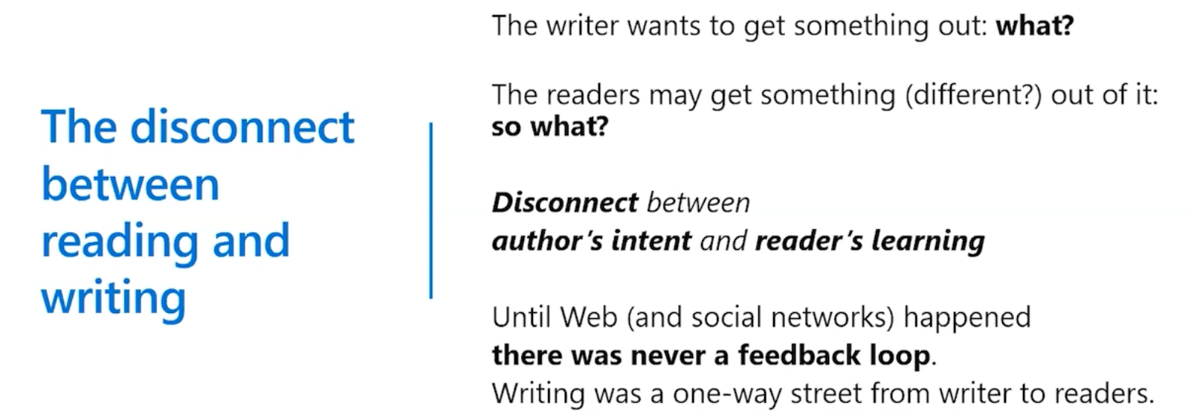

Slide 19
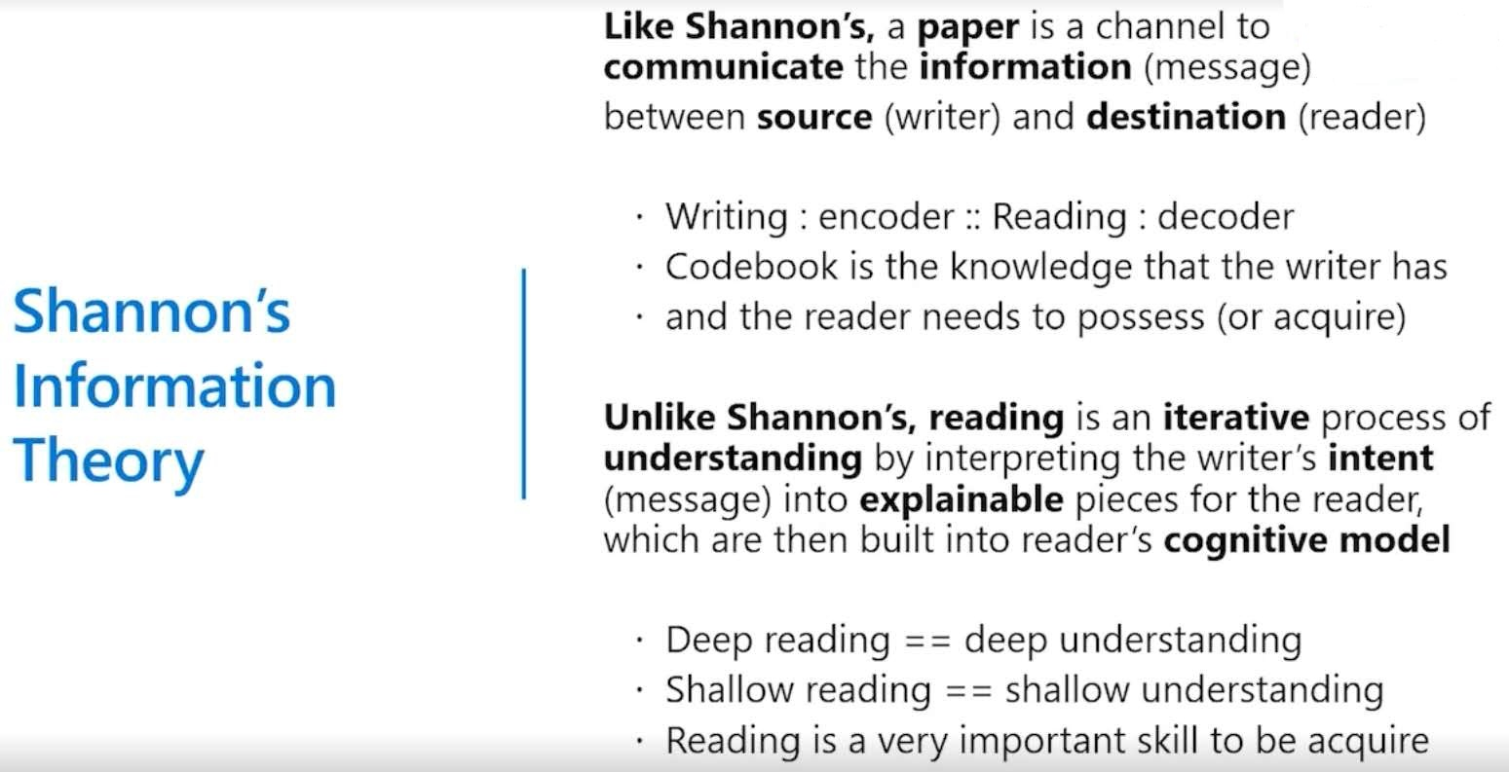
写和读中间隔着香农定律

Slide 20


Slide 21
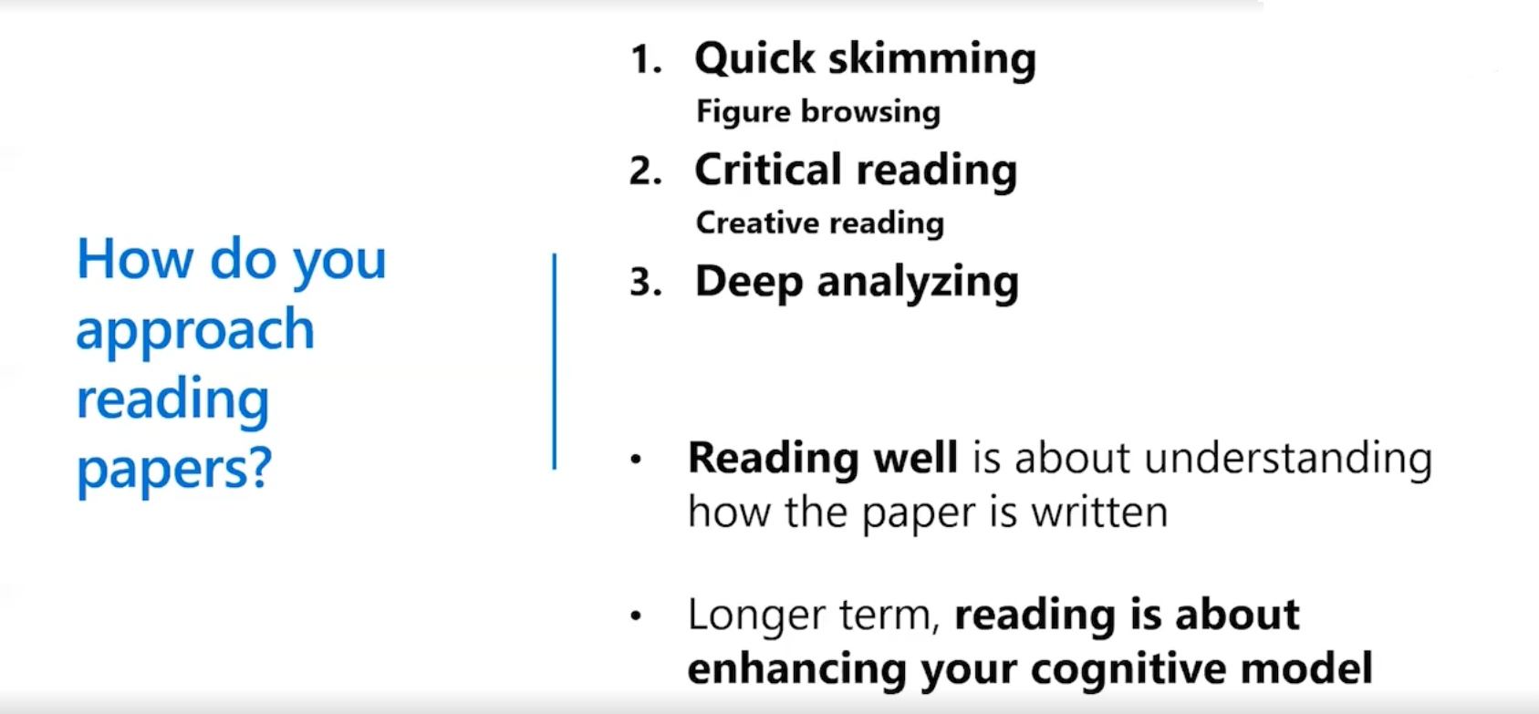

Slide 22
Types of papers
Review articles: overview, state of the art, literature review
Theory pieces: logical argumentation, general to specific
Short communications: research findings, technical solutions, ‘forum’ pieces, ripostes
Empirical studies: experimental, data-driven
Pictorial essay-teaching article with images
Commentary-short article with author’s personal opinions
Editorial-often short review or critique of original articles
Letter to the Editor-short & on subject of interest to readers

Slide 23
Structure of “standard” RAs Or the IMRAD Format
Introduction: What was the question?
provides a rationale for the study
Methods: How did the researcher(s) try to answer it？
Describes methods of data collection and analysis, materials, procedures
Results: What did the researchers find?
Reports findings(with visual/ graphic representations) with some commentary
And
Discussion: What do the results mean?
Interprets and makes sense of findings, and discusses relevance to other research

Slide 24
General
Specific
Introduction (I)
Methods and Materials (M)
Results (R)
Specific
General
Discussion (D)

Slide 25
Organization of a Paper
Title
Abstract
Introduction
Methods
Results
Discussion/ Conclusions
Acknowledgements
References
Note: most scientific journals follow the format of the Structured Abstract. Occasionally, the Result and Discussion are combined-when the date need extensive discussion to allow the reader to follow the train of logic of the research

Slide 26
Title-describes paper's content clearly using
keywords (for databases and search engines)
Abstract-a summary (~ 150-200 words) of the
problem, the method, the results and the
conclusions; the reader can decide whether or
not to read the whole article
Introduction-clearly states the problem being
investigated & reasons for the research;
summarizes relevant research to provide context;
identifies the questions being answered; briefly
describes the experiment, hypothesis(es)，
research question(s) & general experimental
design or method

Slide 27
Methods-provides the reader enough details
so they can understand and replicate the
research; explains how the problem was
studied; identifies the procedures followed;
explains new methodology in detail ; includes the
frequency of observations, what types of data
were recorded, etc.
Results-presents the findings, and explains
what was found; shows how the new results are
contributing to the body of scientific knowledge;
follows a logical sequence based on the tables
and figures presenting the findings to answer the
question or hypothesis(es)

Slide 28
Discussion/Conclusions-describes what the
results mean regarding what was already known
about the subject; indicates how the results
relate to expectations and to the literature
previously cited; explains how the research has
moved the body of scientific knowledge forward;
outlines the next steps for further study
Acknowledgements一recognize various
contributions of other workers
References一the sources of previously
published work; includes information not from
the experiment and not ‘common knowledge’

Slide 29
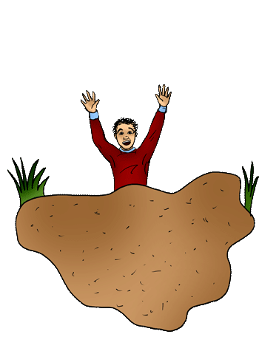
How To Read…
STOP
Don’t Read Straight Through!
It’s like walking through quicksand!

Slide 30
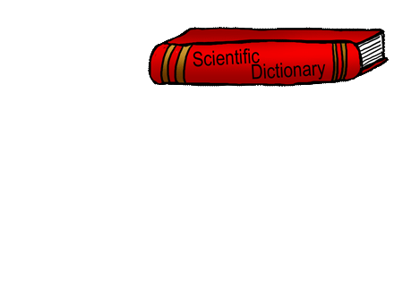
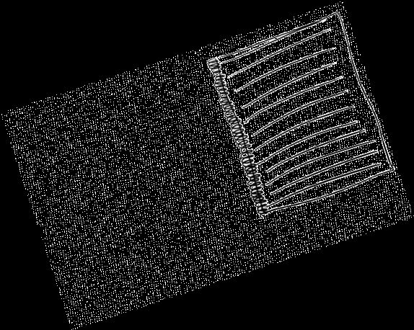
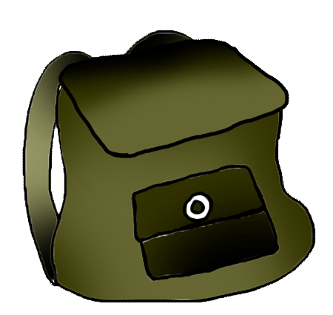

How To Read…
Before you read, you need the right equipment….
A Scientific Dictionary:
Look up terms you don’t know.
Try www.AccessScience.com, for an online dictionary.
Your handy-dandy notebook:
Make notes so you’ll remember your insights.
Your friends and colleagues:
Explaining to others will help you understand the paper yourself.

Slide 31
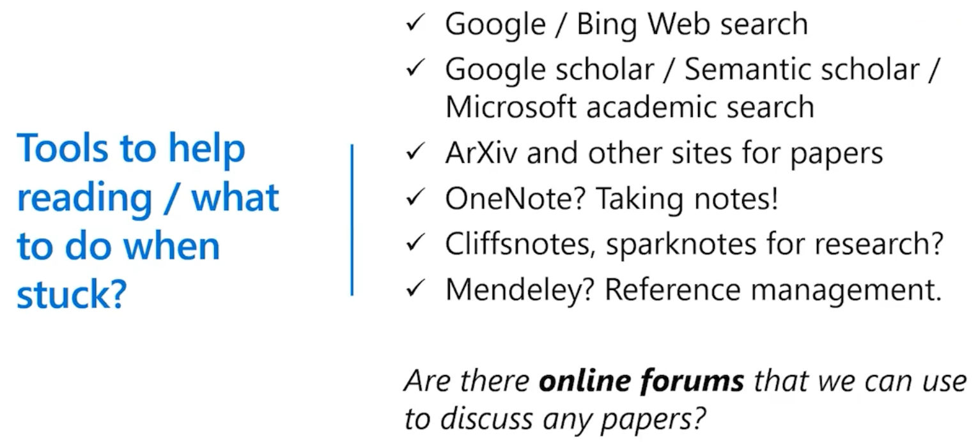

Slide 32
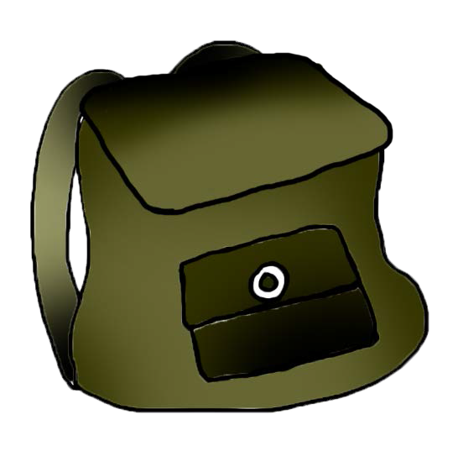
How To Read…
Okay, all packed?
Then, let’s go!

Slide 33
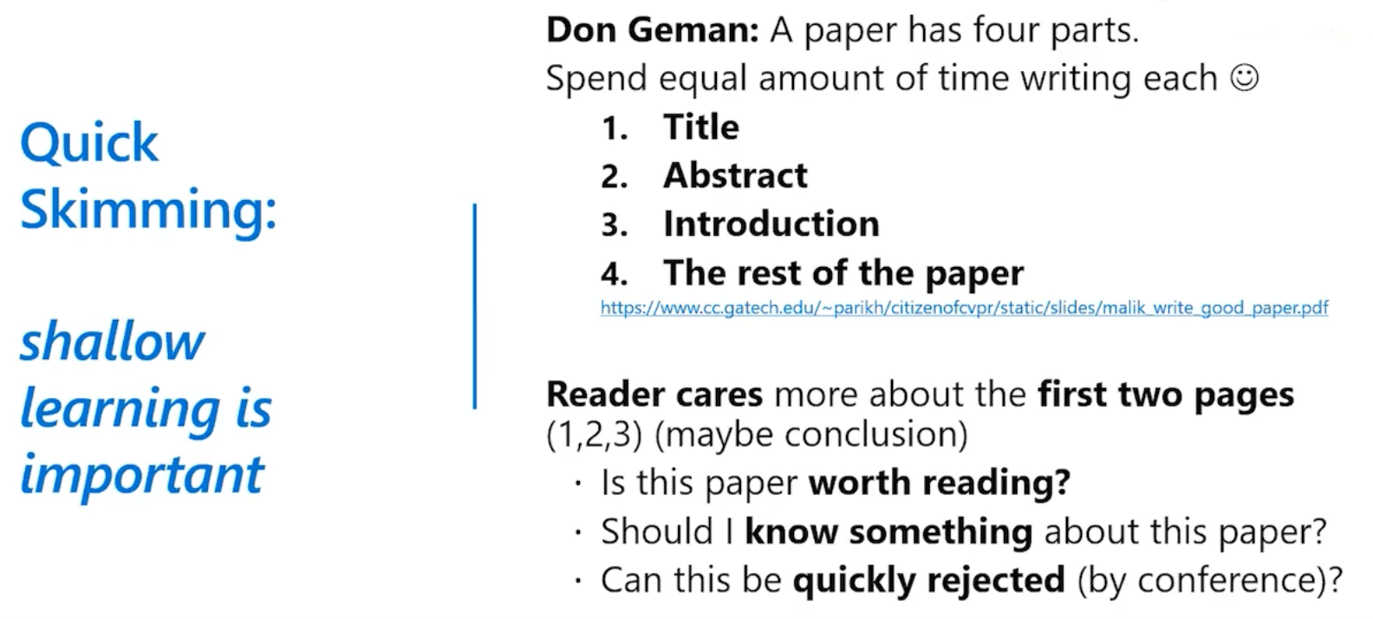

Slide 34
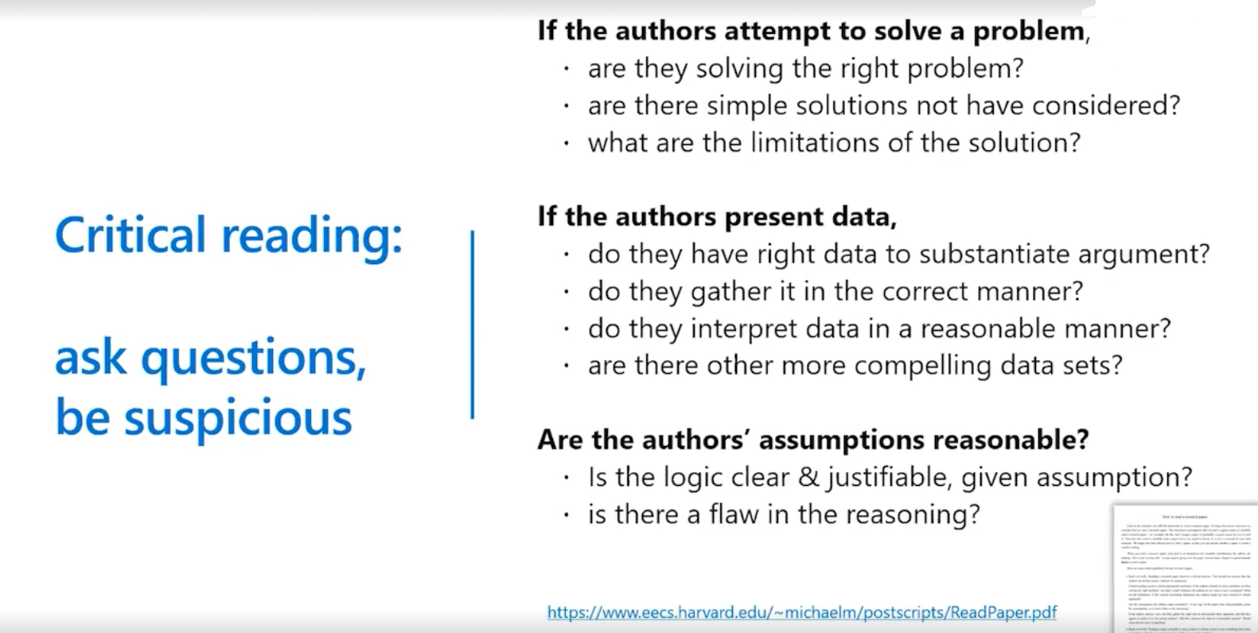

Slide 35
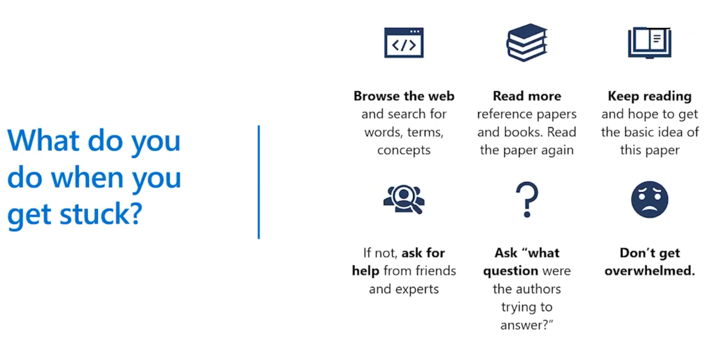

Slide 36
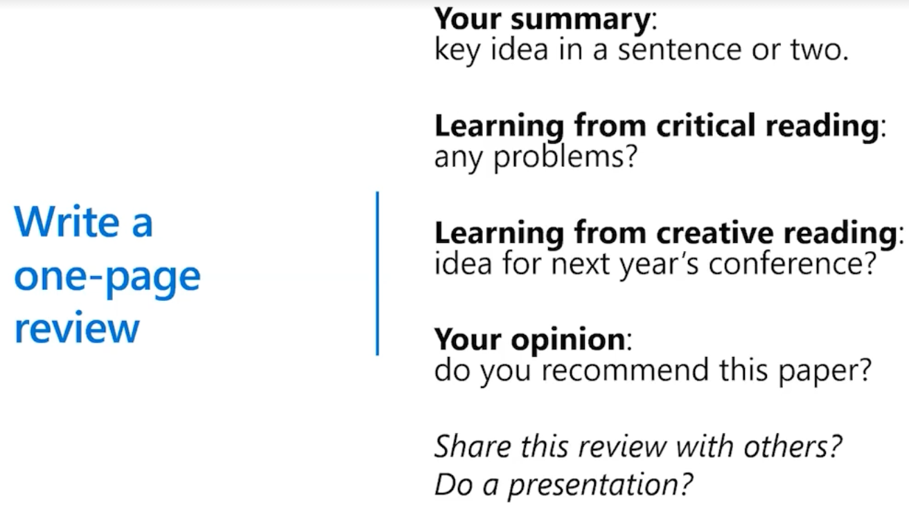

Slide 37
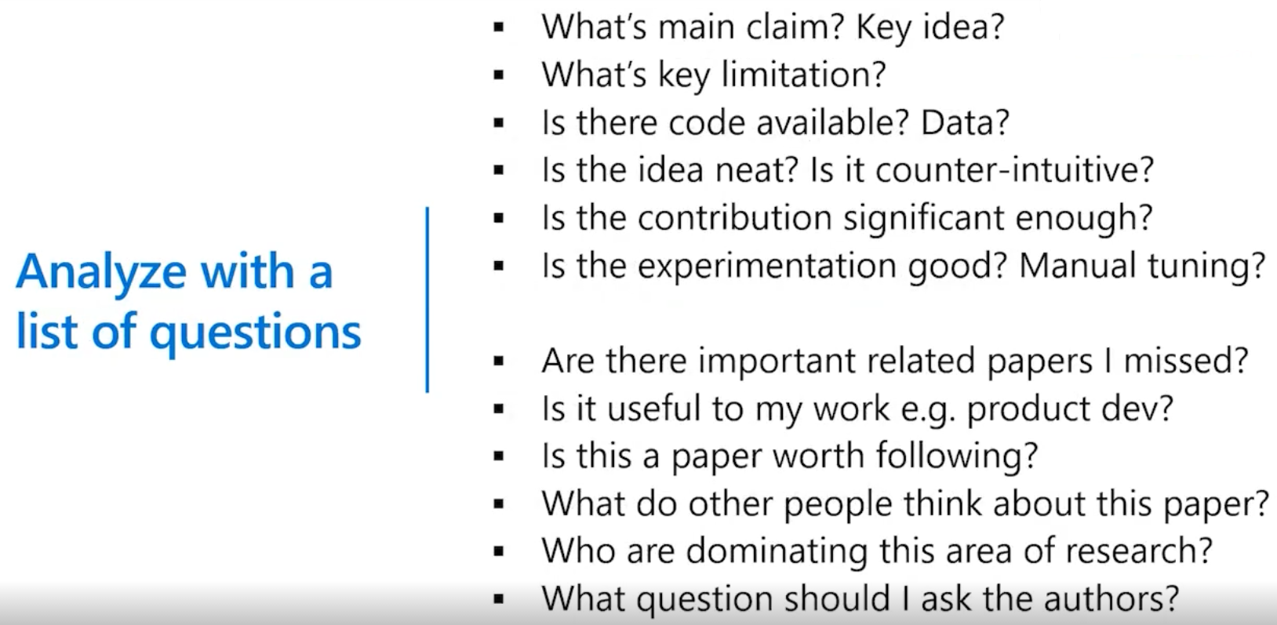

Slide 38
Actions to Take
Skim the article without taking notes：
—Read the abstract; it will tell you the major findings of the article and why they matter
—Read first for the ‘big picture’
—Note any terms or techniques you need to define
—Jot down any questions or parts you don’t understand
—If you are unfamiliar with any of the key concepts in the article , look them up in a textbook

Slide 39
Re-read the article more carefully especially the
‘methods’ and ‘results/ conclusions’ Section:
一Carefully examine the graph, tables, and
diagrams
一Try to interpret the data first before reading the
captions and details
一Make sure you understand the article fully
Ask yourself questions about the study, such as:
一What problems does the study address? Why is
it important? Is the method good? Are the
findings supported by evidence? Are they unique
and supported by other work in the field?

Slide 40
—Is the study repeatable? What was the sample size?
Is this representative of the larger population? What variables were held constant？Was there a control? What factors might affect the outcome?
Write a ‘summary’ of the article
—Describe the article in your own words- to distill the article down to its ‘scientific essence’
—Note the ‘key point’- purpose of the study/questions asked, assumptions, major findings, & conclusions, questions unanswered & any surprises
How to Read and Review a Scientific Journal Article Duke University Writing Studio
twp.duke.edu/uploads/media_items/scientificarticlereview.original.pdf
(accessed 05 November 2013)

Slide 41
Other Useful Hints
Draw inferences (a conclusion reached on the basis of
Evidence and reasoning):
—not everything in an article is stated explicitly; rely on
your prior knowledge/experience and the background
in the article, to draw inferences from the material
Distinguish main point:
—Document level: in title, abstract and keywords
—Paragraph level: look for words/phrases like
unexpected, in contrast to previous work,
hypothesize that, propose, introduce, data suggests

Slide 42
Take notes as you read:
—this improves recall and comprehension; you may think you’ll remember everything but details will slip away
—develop a template for recording notes on articles
—can use the structured abstract format (abstract, introduction , methods, results, discussion,& conclusions, references)
How to read a scientific article: Mary Purugganan & Jan Hewitt, Rice University
www.owlnet.rice.edu/~cainproj/courses/HoeToReadSciArticle.pdf (accessed 05 November 2013)

Slide 43
Additional Resources
Effective Medical Writing．Peh WCG & NG K H
Singapore Medical Journal 2008 49（7）522
smj.sma.org.sg/4907/4907emw1.pdf
How to read a scientific article. Mary Purugganan & Jan Hewitt Rice University www.owlnet.rice.edu/~cainproj/courses/HowToReadSciArticle.pdf
How to read a scientific paper. John W. Little & Roy Parker--University of Arizona
www.biochem.arizona.edu/classes/bioc568/ papers.htm
How to read and review a scientific Journal article. Duke University Writing Studio
twp.duke.edu/uploads/media items/scientificarticlereview. original. pdf

